Slide 1
Introduction to Multi Flows, Expectation and Liquid Clustering in SDP

Slide 2
Learning Objectives
Explain what a flow is and how it relates to a streaming table or materialized view
Describe the difference between a default flow and an explicit flow
Apply the multi-flow pattern to write from multiple sources into a single target table
Explain why multi-flow is preferred over UNION for incremental pipelines
Recall how Liquid Clustering and Data Quality Expectations are configured in Spark Declarative Pipelines

Slide 3
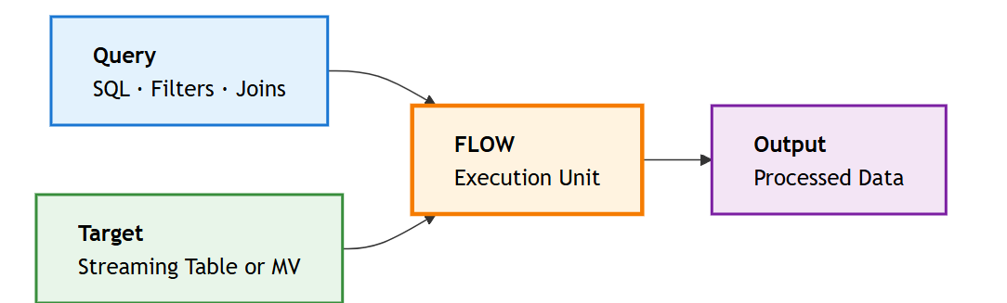
Understanding Flows in Spark Declarative Pipelines
What is Flow?
Flow = Query + Target

Slide 4
Flow
A flow is the basic unit of work in a Spark Declarative Pipeline. Each flow independently reads, processes, and writes data, enabling modular and reliable pipeline updates.
Query
The Query defines what data to read and how to transform it — this is your SQL or DataFrame logic, including filtering, joining, and aggregating.
Target
The Target defines where the results land — either a Streaming Table for incremental ingestion or a Materialized View for computed or aggregated results.

Slide 5
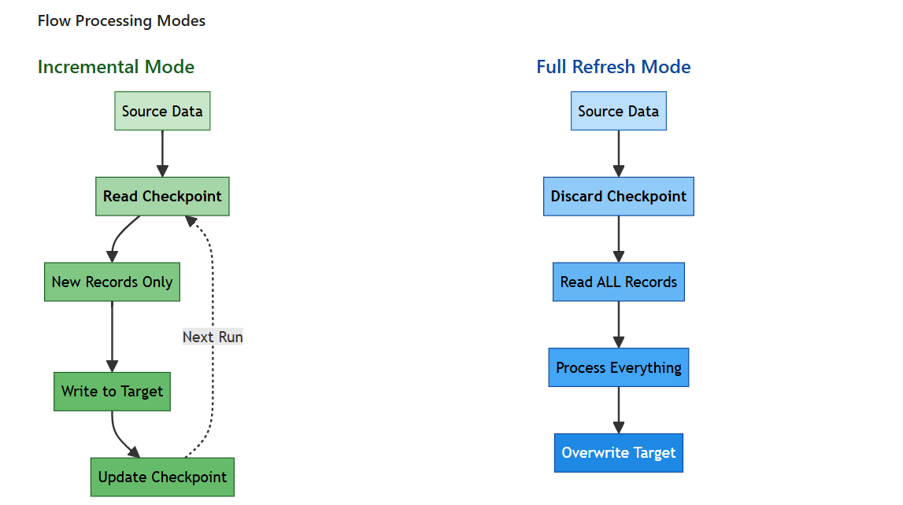
Flow Processing Modes

Slide 6
Processing Modes
Incremental Mode
Processes only new records since the last pipeline run using a checkpoint stored per flow. This is highly efficient for large datasets and streaming sources — on restart, the flow resumes exactly where it left off without reprocessing historical data.
When to use: Ongoing ingestion from streaming sources like Kafka, Auto Loader, or any append-only table.
Full Refresh Mode
Reprocesses all records from the source from scratch — the existing checkpoint is discarded and the target table is fully overwritten. This is more expensive but necessary when business logic changes require recomputing historical data.
When to use: After modifying transformation logic, fixing data quality issues, or when a clean slate is required.

Slide 7
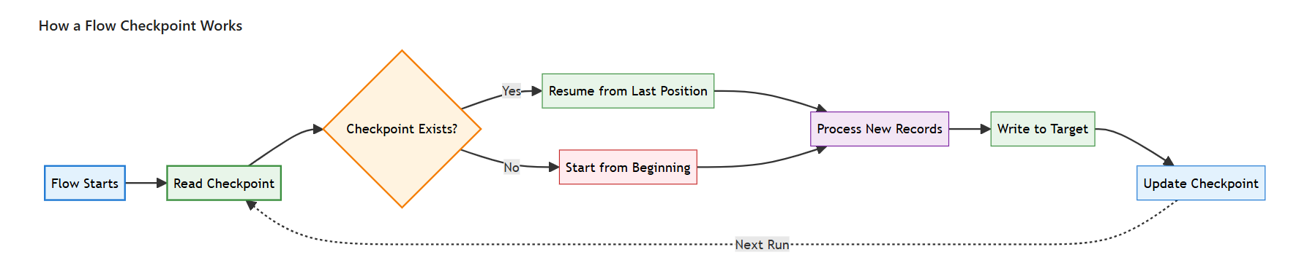
Flow Lifecycle and Checkpoint Management
Each flow maintains its own checkpoint that tracks exactly how far it has read from its source — enabling reliable restarts, independent progress, and failure isolation.

Slide 8
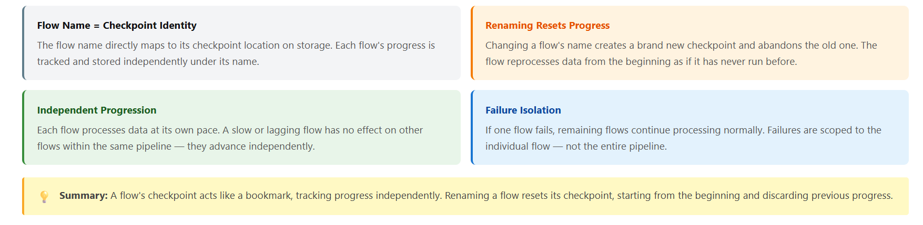
Four Key Rules of Checkpoint Management

Slide 9
Default Flow vs. Explicit Flow
Most of the time, a flow is created automatically and implicitly when you define a streaming table or materialized view. This is the default flow — it shares the name of its target table.
You can also create explicit flows separately from the table definition. This is required when you need to write to an existing table from a new source, or when multiple sources need to converge into one target.

Slide 10
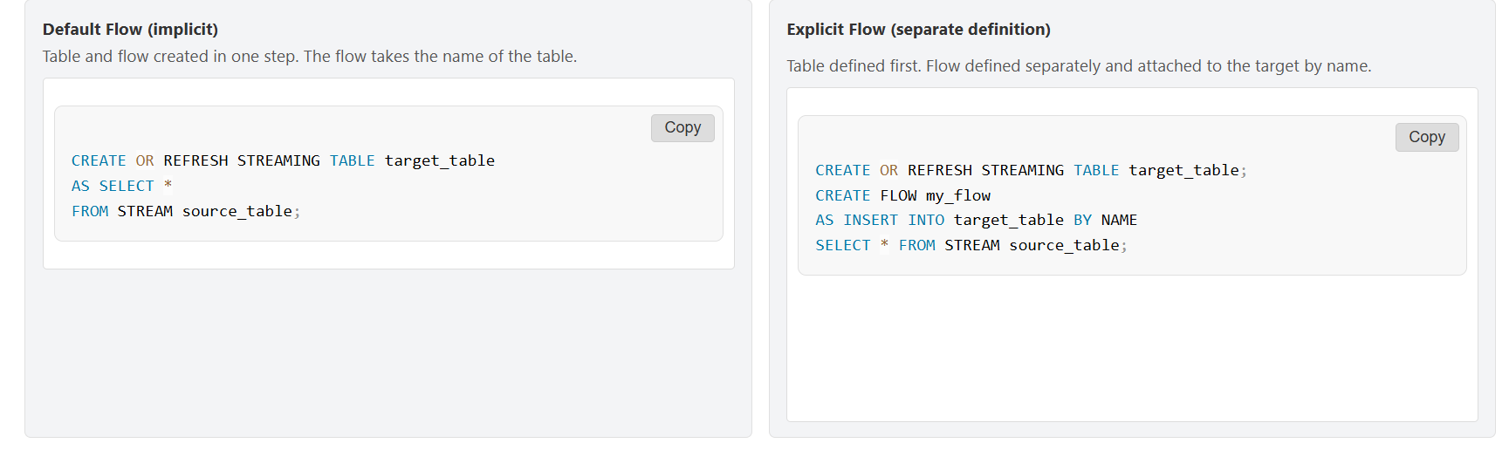

Slide 11
The Multi-Flow Pattern
Writing Multiple Sources into One Target:
The power of explicit flows is that you can define multiple flows targeting the same table. Each flow independently reads from a different source and appends its records to the shared target.
This is the multi-flow pattern — it is the recommended approach when you need to consolidate data from several sources into a single unified table.

Slide 12
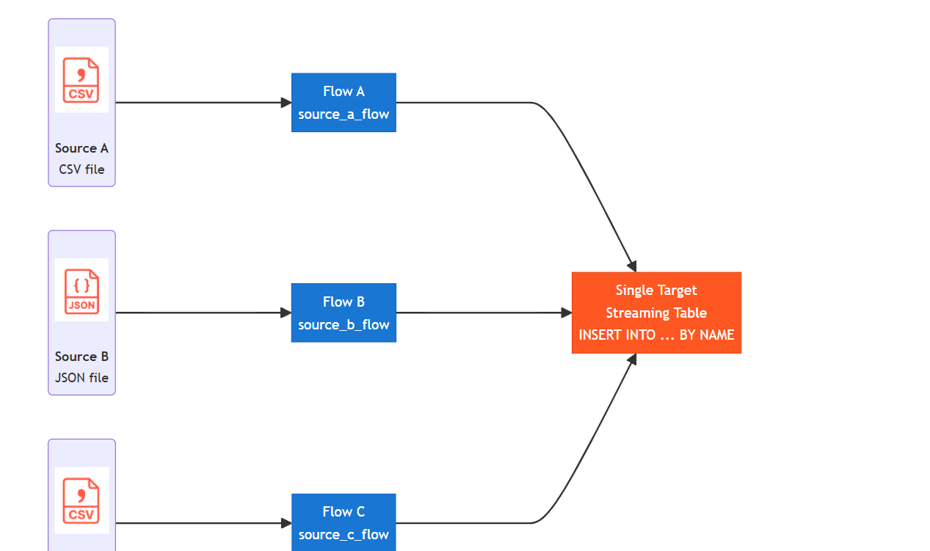
Each flow has its own independent checkpoint — if a new source is added later, only that flow needs to backfill. The other flows are completely unaffected.

Slide 13
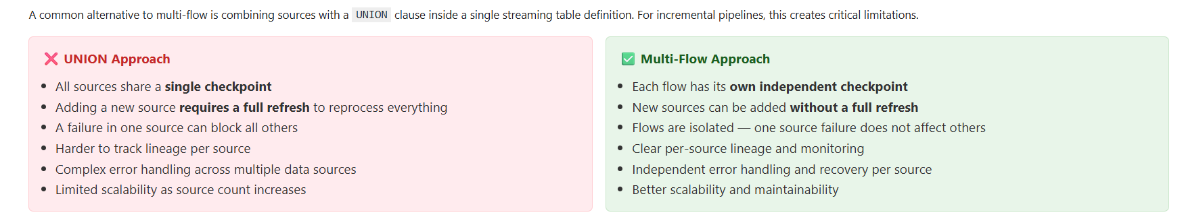
Multi-Flow vs. UNION — Why It Matters

Slide 14
Data Quality Expectations
Data quality means making sure your pipeline only stores valid and reliable records. In Spark Declarative Pipelines, you use expectations to set simple rules directly on streaming tables. If a record breaks a rule, you can choose to warn, drop, or fail the update.
All flows writing to a table follow the same expectations, making it easy to monitor and enforce data quality.

Slide 15
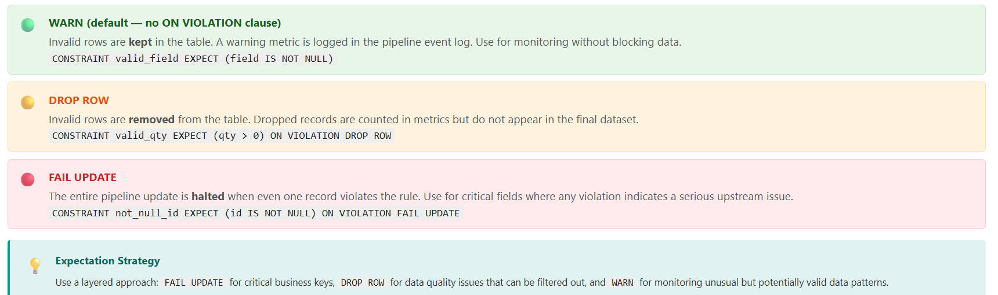
Defining Expectations on Streaming Tables
In Spark Declarative Pipelines, constraints are defined inline in the table's column definition block using CONSTRAINT ... EXPECT. There are three violation modes that control what happens when a record fails a rule:

Slide 16
Expectation Implementation Example
Here's a comprehensive example showing how to implement data quality expectations on a streaming table:
Data Quality Expectations Cannot Be Defined on a Flow
When using the multi-flow pattern, quality constraints must be defined on the target table — not inside the CREATE FLOW or @dp.append_flow definition. The table enforces quality rules centrally for all flows that write to it.
CREATE OR REFRESH STREAMING TABLE streaming_table
(
CONSTRAINT valid_qty EXPECT (qty >= 0) ON VIOLATION DROP ROW,
CONSTRAINT valid_amount EXPECT (total_amount >= 0) ON VIOLATION DROP ROW,
CONSTRAINT not_null_ts EXPECT (order_timestamp IS NOT NULL) ON VIOLATION FAIL UPDATE,
CONSTRAINT valid_email EXPECT (customer_email RLIKE '^[^@]+@[^@]+\\.[^@]+$'),
CONSTRAINT reasonable_qty EXPECT (qty <= 1000) ON VIOLATION WARN
)

Slide 17
Monitoring and Observability
Data quality expectations automatically generate metrics accessible through two channels
Pipeline UI for at-a-glance health
System tables for deep programmatic analysis

Slide 18
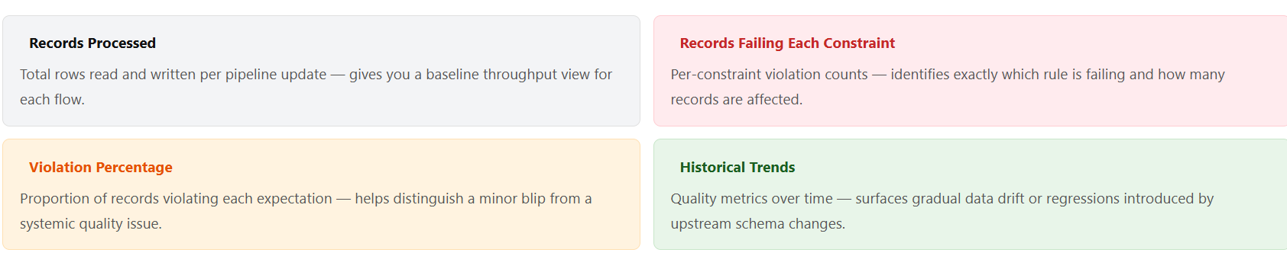

Slide 19
System Tables and Event Logs
The pipeline event log records one row per flow update, capturing both throughput metrics and per-constraint expectation results.
You can query it directly to build custom monitoring dashboards or alert pipelines.
SELECT timestamp, table_name, output_rows,
data_quality.expectations
FROM event_log("pipeline_id")
WHERE event_type = 'flow_progress'
AND data_quality.expectations IS NOT NULL
ORDER BY timestamp DESC;

Slide 20
Liquid Clustering in Spark Declarative Pipelines
What is Liquid Clustering?
Liquid Clustering is a data layout optimization technique in Delta Lake that replaces traditional Hive-style partitioning and Z-Ordering. It organizes data files based on clustering keys to improve query performance through efficient data skipping.

Slide 21
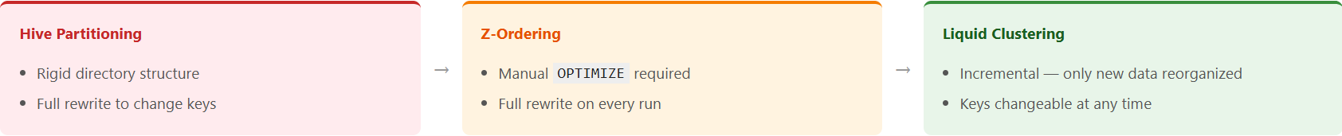
How It Evolved

Slide 22
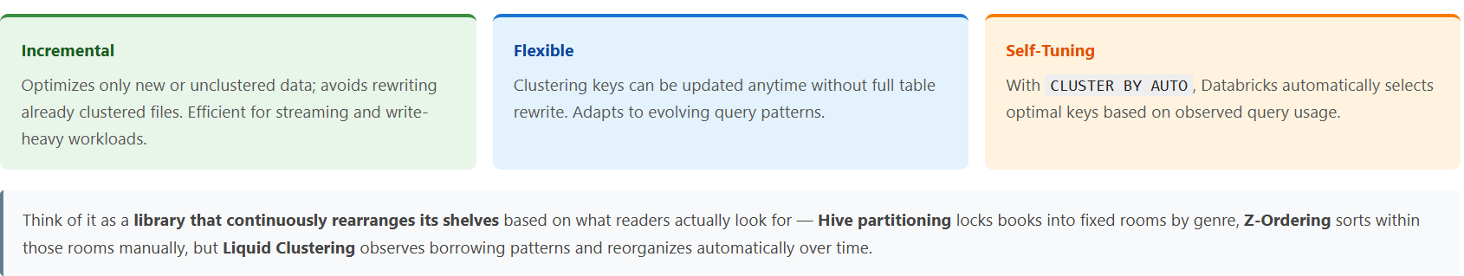
Three Properties That Make Liquid Clustering Powerful

Slide 23
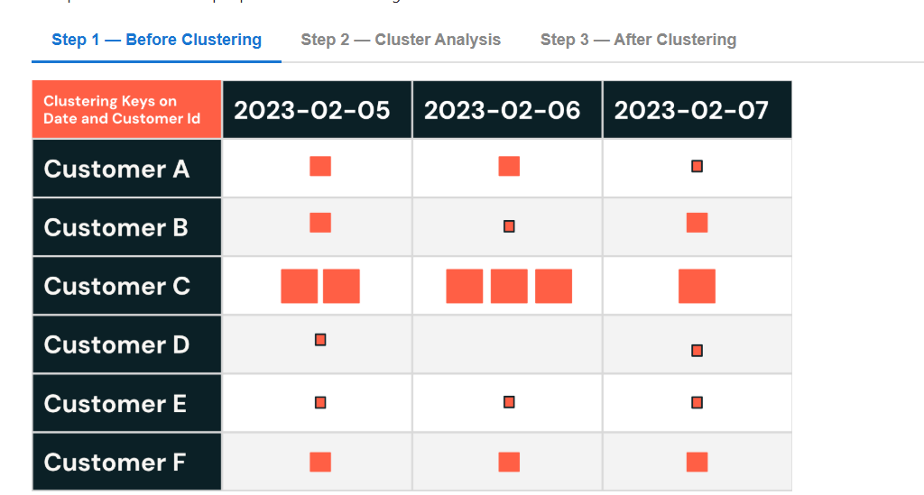
How Liquid Clustering Works
Notes:
Before clustering: Data files are scattered randomly by Date and Customer Id. This means queries must scan all files, even for a single customer or date. Small files exist for low-volume customers (D, E), while high-volume Customer C has larger files. There is no grouping — so performance is poor.

Slide 24
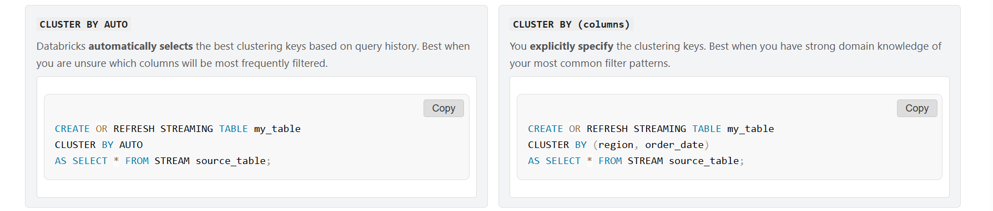
Applying Liquid Clustering to Streaming Tables in SDP
In Spark Declarative Pipelines, it is enabled directly on the streaming table definition using the CLUSTER BY clause — no separate OPTIMIZE command is needed.

Slide 25
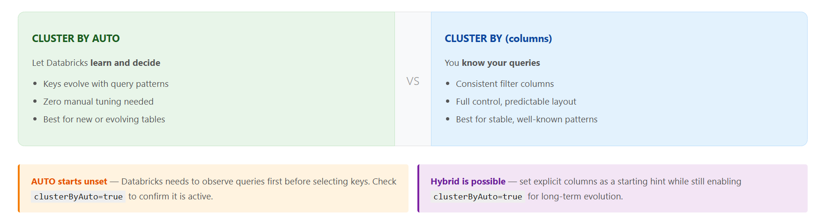
Clustering Strategy Selection

